Slide 1

zekeLabs
Learning made Simpler ! www.zekeLabs.com

Slide 2
Challenges of Microservices
Distributed Systems
Wrong Assumption that the network be reliable, the latency zero, and the bandwidth to be infinite.
Migration
Complex process of blasting your code
Versions
Versioning for microservices can be challenging.
Organization
How to: build an effective team structure,
How to follow a DevOps approach,
How to streamline communication between development and operations.

Slide 3
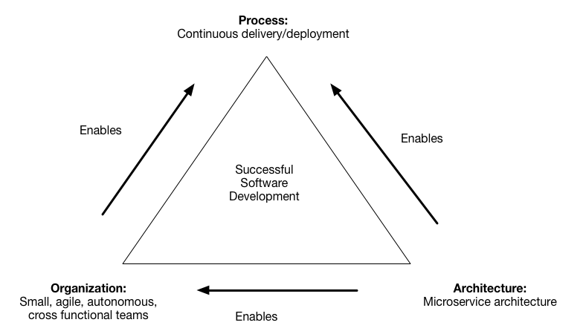
Decompose by business capability

Slide 4
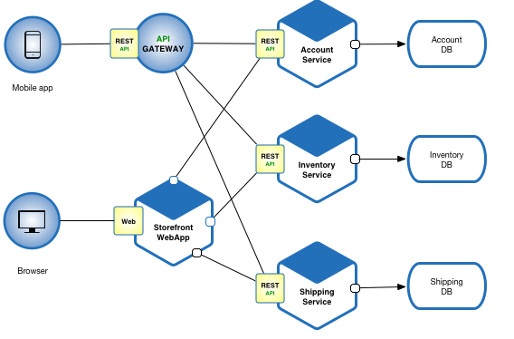
Microservice Architecture - e-commerce application

Slide 5
How to decompose an application to service
The architecture must be stable
A service should implement a small set of strongly related functions.
Services must conform to the Common Closure Principle - things that change together should be packaged together.
Services must be loosely coupled - as an API that encapsulates its implementation.
A service should be testable
Each service be small enough to be developed by a “two pizza” (6-10 people)team.
Each team that owns one or more services must be autonomous to develop and deploy.

Slide 6
Decompose by subdomain
Benefits
Stable architecture since the subdomains are relatively stable
Development teams are cross-functional, autonomous, and organized around delivering business value rather than technical features
Services are cohesive and loosely coupled
Issues
How to identify the subdomains
Organization structure - different groups within an organization might correspond to subdomains
High-level domain model - subdomains often have a key domain object

Slide 7
Deployment Patterns

Slide 8
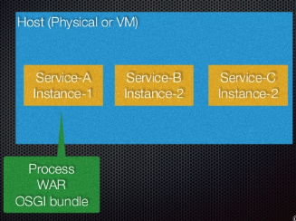
Multiple Service Instances per host

Slide 9
Multiple Service Instances per host
Run multiple instances of different services on a host
Benefits
More efficient resource utilization than the Service Instance per host pattern
Drawbacks
Risk of conflicting resource requirements
Risk of conflicting dependency versions
Difficult to limit the resources consumed by a service instance
difficult to monitor the resource consumption of each service instance.
Difficult to isolate each instance

Slide 10
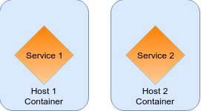
Single Service Instances per host

Slide 11
Single Service Instances per host
Deploy each single service instance on its own host
Benefits
Services instances are isolated from one another
There is no possibility of conflicting resource requirements or dependency versions
A service instance can only consume at most the resources of a single host
Its straightforward to monitor, manage, and redeploy each service instance
Drawbacks
Potentially less efficient resource utilization compared to Multiple Services.

Slide 12
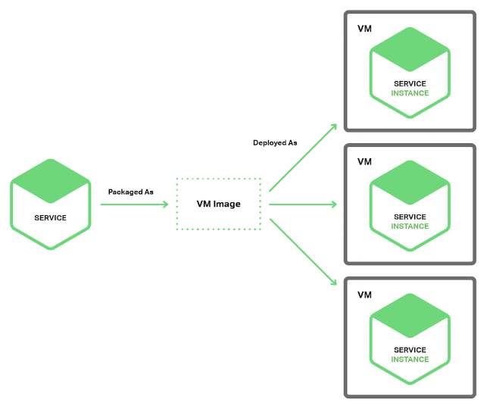
Service Instances per VM

Slide 13
Service Instances per vm
Benefits
Its straightforward to scale the service by increasing the number of instances. Amazon Autoscaling Groups can even do this automatically based on load.
The VM encapsulates the details of the technology used to build the service.
Each service instance is isolated
A VM imposes limits on the CPU and memory consumed by a service instance
Drawbacks
Building a VM image is slow and time consuming

Slide 14
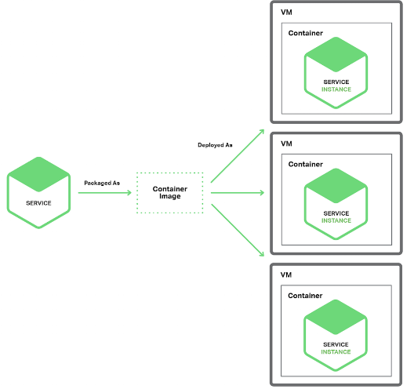
Service Instance per container

Slide 15
Service Instance per container
Package the service as a (Docker) container image and deploy each service instance as a container
Examples
Swarm
Kubernetes
Amazon EC2 Container Service (ECS and EKS)
Azure container service (Docker, Mesos and Kubernetes)

Slide 16
Service Instance per container
Benefits
Easy to scale in and out a service
The container encapsulates the details of the technology used to build the service.
All services are started and stopped in exactly the same way.
Each service instance is isolated.
A container imposes limits on the CPU and memory consumed by a service instance
Containers are extremely fast to build and start.
Drawbacks
The infrastructure for deploying containers is not as rich as the infrastructure for deploying virtual machines.

Slide 17
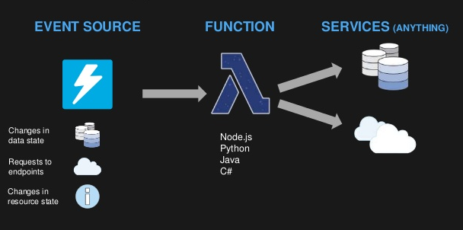
Serverless Deployment

Slide 18
Serverless Deployment
To deploy your service using this approach, you package the code, upload it to the deployment infrastructure and describe the desired performance characteristics.
Examples
AWS Lambda
Google Cloud Functions
Azure Functions

Slide 19
Serverless Deployment
Benefits
Eliminates the need to spend time on infrastructure.
Extremely elastic.
You pay for each request and only for total compute time
Drawbacks
Less control than a VM-based or Container-based infrastructure. Eg: Support for languages
Limited input sources
serverless deployment is not a good fit your service takes a long time to start
Risk of high latency

Slide 20
Service Deployment Platform
An automated infrastructure for application deployment.
Shall provide a service abstraction,
A set of highly available (e.g. load balanced) service instances.
Examples
Docker orchestration frameworks including Docker swarm mode and Kubernetes
Serverless platforms such as AWS Lambda
PaaS including Cloud Foundry and AWS Elastic Beanstalk

Slide 21
Communication Style

Slide 22
Remote Procedure Invocation (RPI)
Use RPI for inter-service communication.
The client uses a request/reply-based protocol to make requests to a service.
Examples
REST
gRPC
Apache Thrift

Slide 23
Messaging
Use asynchronous messaging for inter-service communication.
Services communicating by exchanging messages over messaging channels.
Examples
Apache Kafka
RabbitMQ
Azure queue

Slide 24
Domain-specific protocol
Use a domain-specific protocol for inter-service communication.
Examples
Email protocols such as SMTP and IMAP
Media streaming protocols such as RTMP, HLS, and HDS

Slide 25
External API

Slide 26
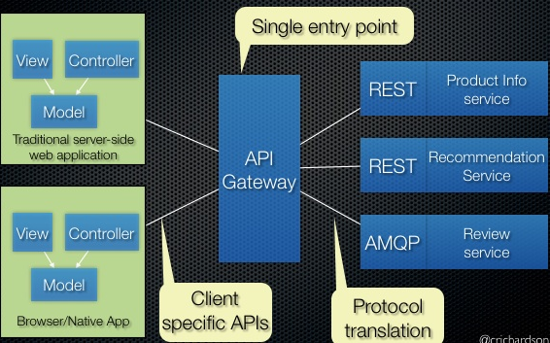
API Gateway

Slide 27
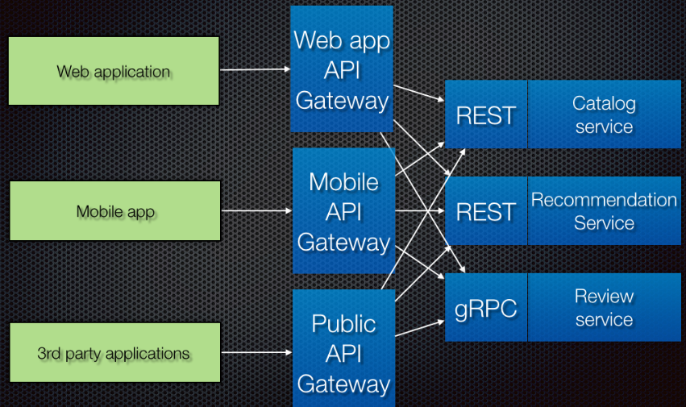
Backend For Frontend
Defines a separate API gateway for each kind of client.

Slide 28
Transactional Messaging

Slide 29
Transactional Messaging
Application publishes events
The application insert events into an EVENTS table
A separate process polls the EVENTS table and publishes the events to a message broker.
Transaction log tailing
Tail the database transaction log and publish each change as an event.
Polling publisher
Publish messages by polling the outbox in the database.

Slide 30
Service Discovery

Slide 31
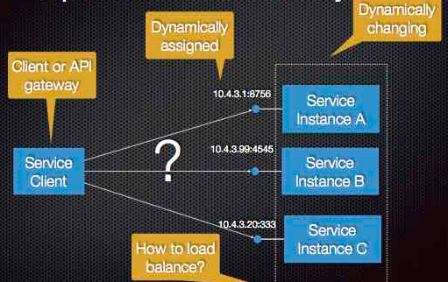
Problem of discovery
The number of instances of a service and their locations changes dynamically.

Slide 32
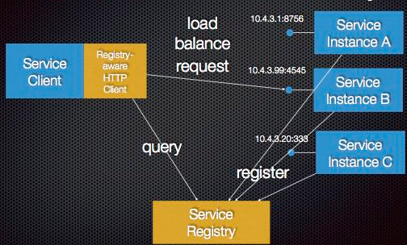
Client-side service discovery
When making a request to a service, the client obtains the location of a service instance by querying a Service Registry, which knows the locations of all service instances.

Slide 33
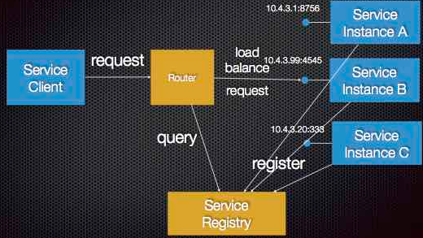
Server-side service discovery
The client makes a request via a router (load balancer) that runs at a well known location.
The router queries a service registry
Forwards the request to an available service instance.

Slide 34
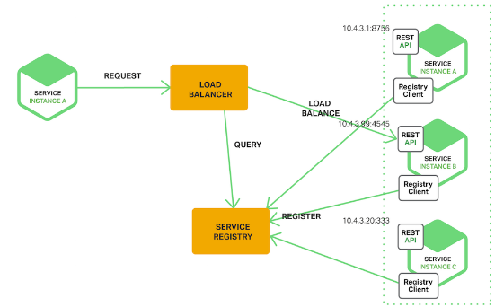
Service Registry
Service instances are registered with the service registry on startup and deregistered on shutdown.
A service registry might invoke a service instances health check

Slide 35
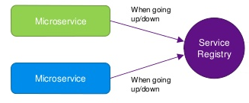
Self Registration
On startup the service instance registers itself (host and IP address) with the service registry and makes itself available for discovery.
On shutdown the service instance unregisters itself from the service registry.

Slide 36
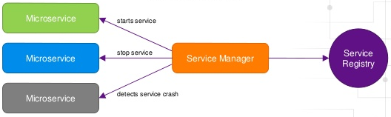
Third Party Registration
A 3rd party registrar is responsible for registering and unregistering a service instance with the service registry.
When the service instance starts up, the registrar registers the service instance with the service registry. When the service instance shuts downs, the registrar unregisters the service instance from the service registry.
Eg: Netflix Prana, AWS Autoscaling Groups

Slide 37
Database

Slide 38
Database Management
Database per service
Keep each microservices persistent data private to that service
Accessible only via its API
Shared database
Use a single database that is shared by multiple services.
Each service freely accesses data owned by other services

Slide 39
Event Management
Event Sourcing
Applications persist events in an event store, which is a database of events.
The event store also behaves like a message broker.
Application Events
The application insert events into an EVENTS table as part of the local transaction.
A separate process polls the EVENTS table and publishes the events to a message broker.
API Composition
Implement a query by defining an API Composer, which invoking the services that own the data and performs an in-memory join of the results

Slide 40
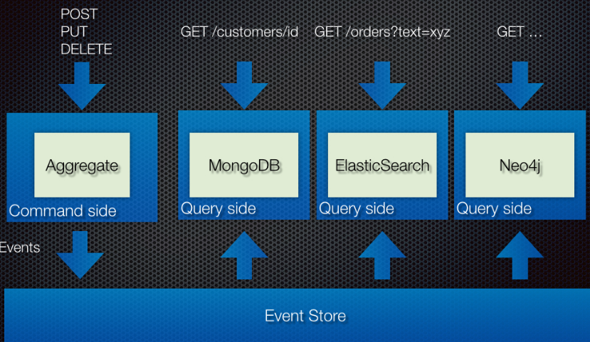
Command Query Responsibility Segregation (CQRS)

Slide 41
Command Query Responsibility Segregation (CQRS)
Split the application into two parts: the command-side and the query-side.
The command-side handles create, update, and delete requests and emits events when data changes.
The query-side handles queries by executing them against one or more materialized views that are kept up to date by subscribing to the stream of events emitted when data changes.

Slide 42
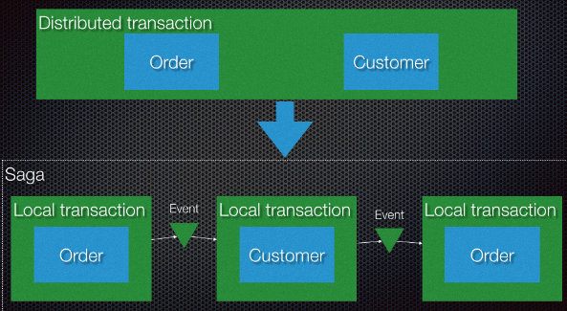
Saga
A saga is a sequence of local transactions.
Each local transaction updates the database and publishes a message or event to trigger the next local transaction in the saga.

Slide 43
Security

Slide 44
Access Token
The API Gateway authenticates the request and passes an access token (e.g. JSON Web Token) that securely identifies the requestor in each request
Benefits
The identity of the requestor is securely passed around the system
Services can verify that the requestor is authorized to perform an operation

Slide 45
Testing
Service Component Test
A test suite that tests a service in isolation using test doubles for any services that it invokes.
Service Integration Contract Test
A test suite for a service that is written by the developers of another service that consumes it. The test suite verifies that the service meets the consuming service’s expectations.
Consumer-side contract test
Verify that the client of a service can communicate with the service.

Slide 46
Observability
Log aggregation
Use a centralized logging service that aggregates logs from each service instance.
The users can search and analyse the logs.
Configure alerts that are triggered when certain messages appear in the logs.
Application Metrics
Instrument a service to gather statistics about individual operations.
Aggregate metrics in centralized metrics service,
Provide reporting and alerting.

Slide 47
Observability
Audit Logging
Record user activity in a database.
Health Check API
Returns the health of the service.
Log deployments and changes
Log every deployment and every change to the (production) environment.

Slide 48
Front-end

Slide 49
UI Patterns
Each team developers a web application that generates the HTML fragment that implements the region of the page for their service.
A UI team is responsible for developing the page templates that build pages

Slide 50
THANK YOU !
Let us know how can we help your organization to Upskill the employees to stay updated in the ever-evolving IT Industry.
Get in touch:
www.zekeLabs.com | +91-8095465880 | info@zekeLabs.com
Visit : www.zekeLabs.com for more details

